Slide 1
Infinitives + Adjectives Infinitives + Nouns
* See slide notes for page directions
Notes:
When listing all project collaborators, either use commas or bullets

Slide 2
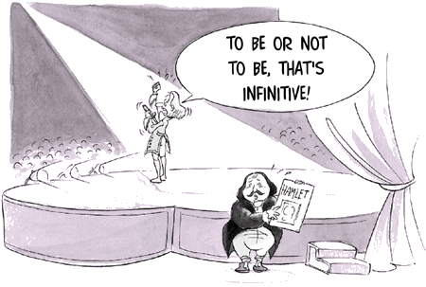
Notes:
Insert a map of your colony (draw it, ink it, or create it in PPT- be creative!)
Insert -> Pictures for photos
Draw for digital inking
Insert -> Shapes if you want to create it in PPT
All mountains, towns/villages, bodies of water/waterways, landmarks, etc. should be clearly labeled

Slide 3
Definition
Infinitives are a special form of verbs that can be used as a noun, adjective, or adverb. They are usually made by adding the word to before the base verb, and they can be useful when discussing actions without actually doing the action, such as “I want to go home,” or “To err is human.”
The infinitive form is crucial to English and many other languages, but the grammar rules for infinitives can be tricky. In this lecture, lets learn all about the different types of infinitives and how to use them, including clear infinitive examples so you can see how they work.

Slide 4
There are two main types of infinitives: full infinitives and bare infinitives.
Full infinitives, also known as to-infinitives, are the most common infinitives in writing. You can create a full infinitive by taking the base form of a verb and adding to in front of it. For example, the verb be—which is often conjugated to is, are, was, were, etc.—becomes the full infinitive to be, as in Shakespeare’s famous infinitive example from Hamlet:
To be or not to be . . .

Slide 5
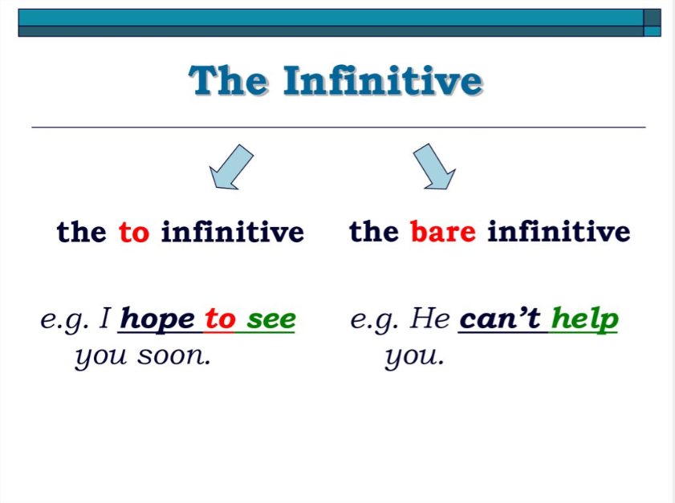

Slide 6
Full infinitives are used in the following situation:
To show purpose or intention
Infinitives are used to explain why someone is doing something, often replacing the phrase “in order to.” In this case, they act as adverbs to describe the main verb.
Mom left to buy milk.
I’m writing this email to tell you something important.
Did you come to college to study or to party?
Unlike an adverbial clause, an infinitive phrase used as an adverb does not need an active verb.

Slide 7
Full infinitives are used in the following situation:
To modify nouns
Just like how full infinitives can add extra information about verbs, they can also modify the meanings of nouns. In this case, they act as adjectives and adjective phrases.
We need a hero to save us.
Would you like something to drink?
It was a dumb thing to say, and I regret it.

Slide 8
Full infinitives are used in the following situation:
As the subject of a sentence
If you want to talk about an action in general as the subject of the sentence, use the full infinitive form.
To love someone requires patience and understanding.
To go this late seems pointless.
To unlearn is the highest form of learning.

Slide 9
Full infinitives are used in the following situation:
After adjectives
Full infinitives can add context or extra description when used after adjectives.
I’m happy to be here.
Isn’t it nice to leave the city?
Computers are easy to use with practice.

Slide 10
Full infinitives are used in the following situation:
With the words too or enough
When using the adverbs too and enough, we use the full infinitive to explain why. In these cases, the infinitive is often unnecessary, but it’s nonetheless a helpful addition if the sentence is vague.
I have too many books to fit in my backpack.
We collected enough firewood to last the winter.
They were old enough to vote but not to drink.

Slide 11
Full infinitives are used in the following situation:
Phrases with most relative pronouns
Use the full infinitive in phrases that start with one of the relative pronouns who, whom, what, where, when, and how—but not why.
I don’t understand how to beat the Level 5 boss.
Playing cards is about knowing when to hold them and when to fold them.
Here’s a list of whom to call in an emergency.
Keep in mind that you only use full infinitives when relative pronouns are used as phrases, but not typically when used for questions:
Correct: I don’t know what to do.
Incorrect: What to do?

Slide 12
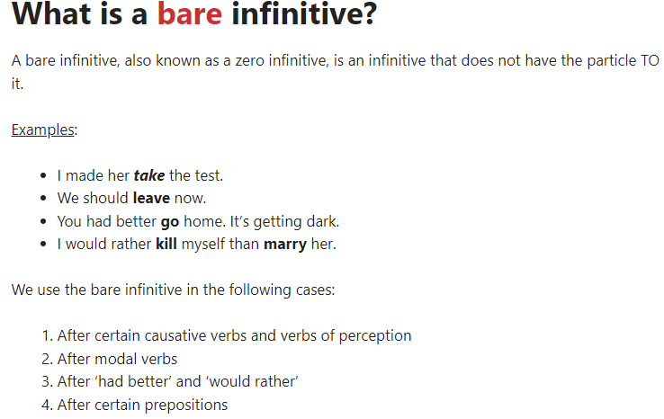

Slide 13
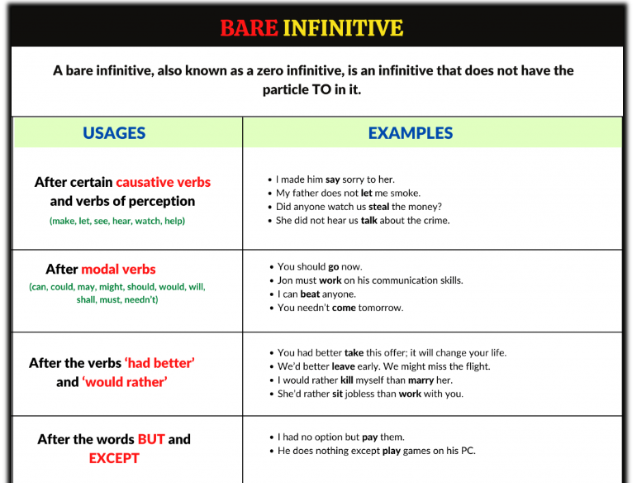

Slide 14
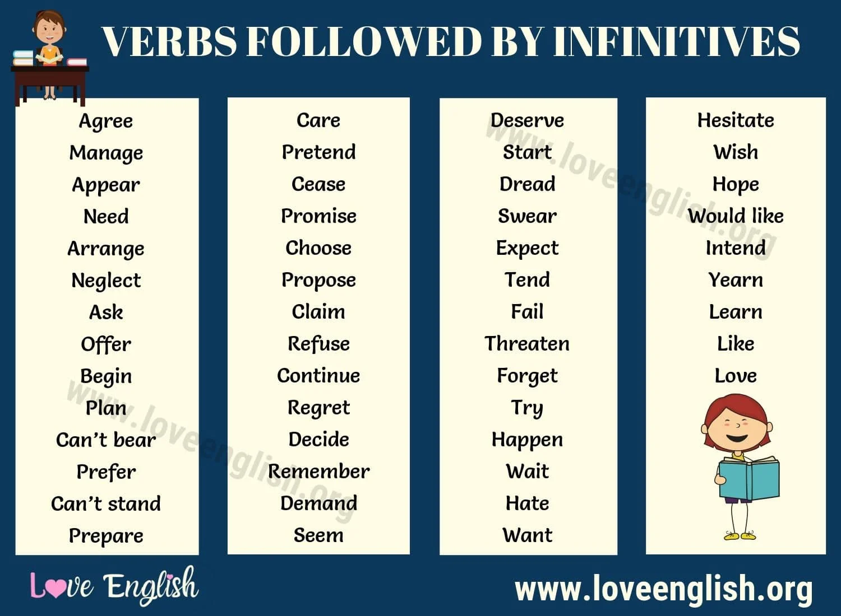
Notes:
Insert a map of your colony (draw it, ink it, or create it in PPT- be creative!)
Insert -> Pictures for photos
Draw for digital inking
Insert -> Shapes if you want to create it in PPT
All mountains, towns/villages, bodies of water/waterways, landmarks, etc. should be clearly labeled

Slide 15
Examples
1
2
3
To stay up late at night is harmful to health.
(Infinitive used as noun, being the subject to the verb is.)
There is no need to stay up late at night.
(Infinitive used as adjective, post-modifying the noun need.)
To stay up late at night, we relaid the fire with coal.
(Infinitive as adverb, modifying the verb relaid, showing the purpose, we relaid….)
Notes:
What are the rules and laws of your colony? Think about what helps the colonists stay safe and maintain a healthy, happy colony.
In each shape…
Name the rule/law
Describe why it’s important for the colony/colonists
Explain the consequences for not following this rule/law
To add more shapes, click on the last shape, then on SmartArt Tools -> Design -> Add Shape After

Slide 16
We can often use infinitives after adjectives to tell why the subject feels a certain way. Subject + be verb + adjective + infinitive
I am happy to help you.
She was afraid to ask for help.
He was angry to hear about getting fired.
I am reluctant to quit my job.
I am sorry to bother you.
It will be easy to do.
It is going to be hard to finish on time.
She has been determined to succeed.
It is likely to rain tomorrow.
Adjective
+
Infinitive

Slide 17
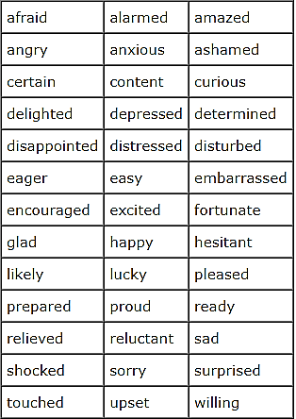
List of Adjectives used mostly with infinites
Notes:
Insert a map of your colony (draw it, ink it, or create it in PPT- be creative!)
Insert -> Pictures for photos
Draw for digital inking
Insert -> Shapes if you want to create it in PPT
All mountains, towns/villages, bodies of water/waterways, landmarks, etc. should be clearly labeled

Slide 18
There is also another very common sentence structure that has an infinitive after an adjective. This sentence shows why it is not a good idea to do something or why something is impossible to do. Subject + be verb + too + adjective + infinitiveThis mountain is too high to climb.
It is too cold to go swimming.
It is too hot to exercise outside.
This book is too hard to read.
Many economists consider banks to be too big to fail.
Adjective
+
Infinitive

Slide 19
We can add "for + person" to be more specific about who or what group of people that we are talking about.This mountain is too dangerous for children to climb, but it is okay for adults.
This shirt is too expensive for me to buy.
That English book is too hard for me to study.
We don't need the infinitive if both the speaker and listener already know what it is.This book is too hard for me (to read).
This food is too spicy for her (to eat).
Adjective
+
Infinitive

Slide 20
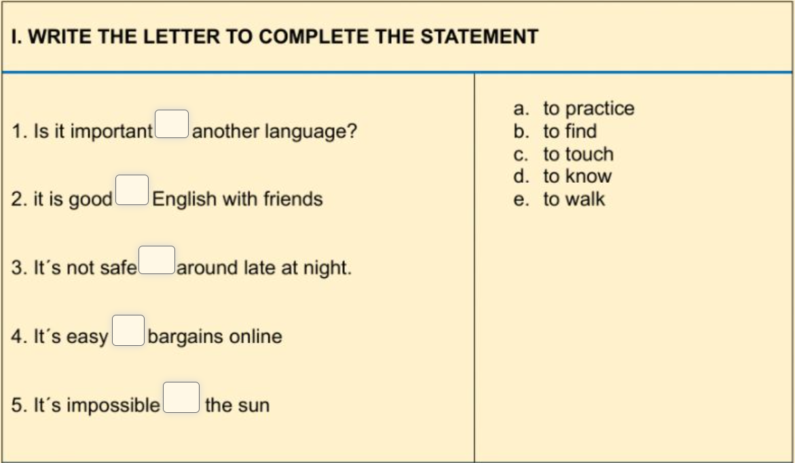

Slide 21
If there is a noun or pronoun following the main verb, it should be followed by the infinitive form. Examples:
I asked my friend to help me move next Saturday.
She wanted him to call her.
My coworkers need me to finish the project on time.
The teacher advised her students to study for the test.
The last example with the verb “advise” shows just how useful this rule is. Advise is usually followed by a gerund (Our teacher advised studying for the test), but when you add a noun/pronoun object, the noun + infinitive rule takes precedence (The teacher advised her students to study for the test).
Noun
+
Infinitive

Slide 22
Spend/Waste Time + Gerund
While the noun + infinitive rule works in almost every case, there is a common exception involving time. When the phrases spend time or waste time are used, the noun “time” is NOT followed by an infinitive. A gerund always follows these phrases. Also note that the noun “time” can be replaced by an amount of time (using the nouns months, days, hours, minutes, etc.) and a gerund is still required.
Noun
+
Infinitive
(The Exception)

Slide 23
Examples:
I spent time working on my project last night.
He wastes a lot of time watching TV.
My sister is spending five hours helping out at the auction.
They have wasted four days arguing about it.
Noun
+
Infinitive

Slide 24
Examples:
I spent time working on my project last night.
He wastes a lot of time watching TV.
My sister is spending five hours helping out at the auction.
They have wasted four days arguing about it.
But be careful! If the noun “time” is not part of the spend time/waste time phrase, the normal noun + infinitive rule applies.
I have time to help you today.
They need more time to finish the test.
Noun
+
Infinitive

Slide 25
